Slide 1
Parameter Sensitivity:
FAST and PRMS

Slide 2
Sensitivity Analysis
Fourier Amplitude Sensitivity Test (FAST)
FAST is a variance-based global sensitivity algorithm that estimates the first-order partial variance of model output explained by each parameter
FAST has been implemented as the ‘fast’ library in the statistical software R

Slide 3
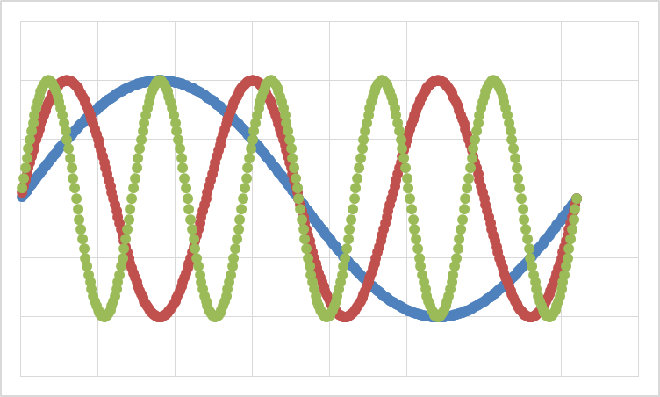
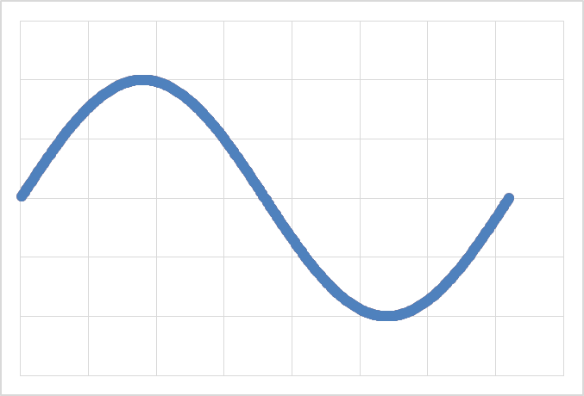
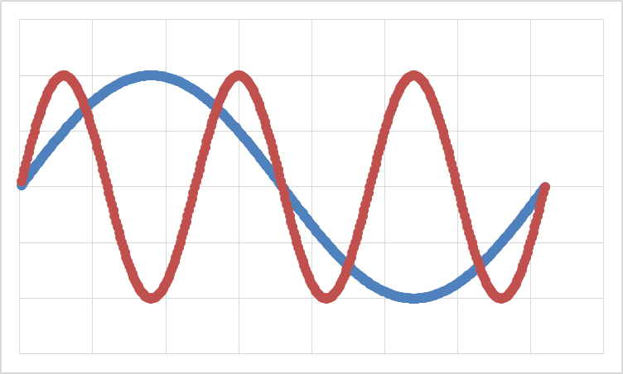
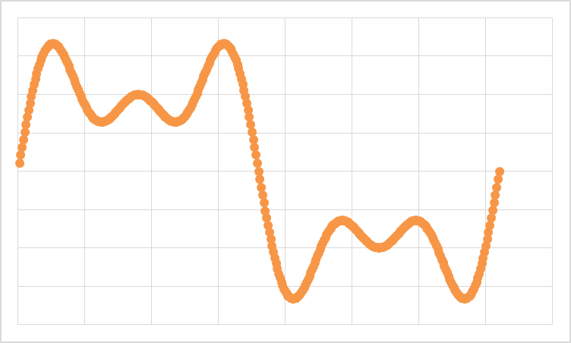
Fourier amplitude sensitivity testing (FAST)
U_{sim}
P₂
P₃
P₁
Number of trials

Slide 4
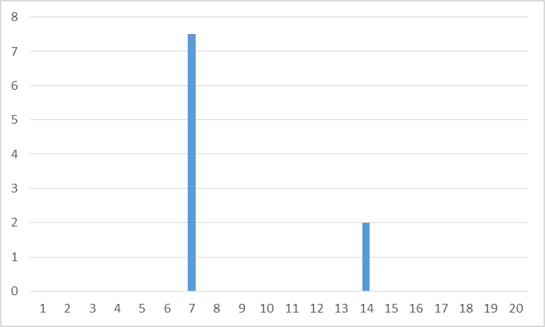
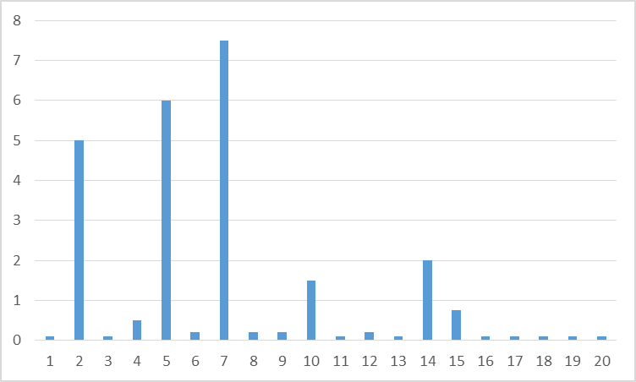
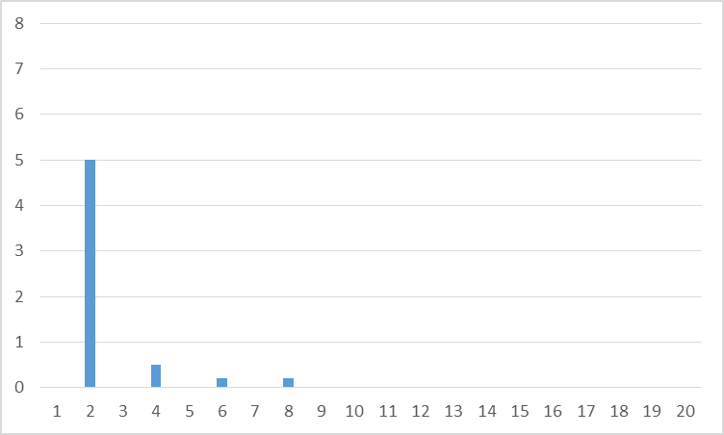
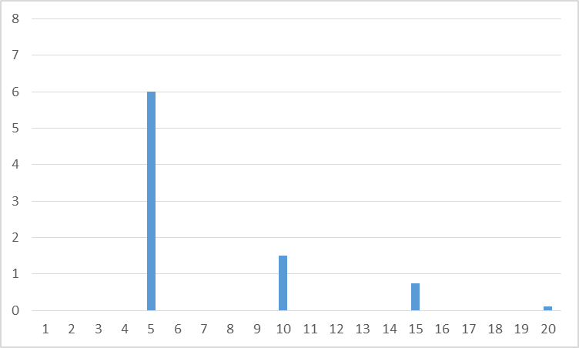
Fourier amplitude sensitivity testing (FAST)
P₁
P₃
P₂

Slide 5
prmsFast
Parameter sensitivity for PRMS
Written in R and Java
Sits on top of PRMS workspace
No distribution/documentation
demo

Slide 6
PRMS Parameter Sensitivity at CONUS Scale
Model parameters (35)
adjmix_rain
carea_max
cecn_coef
dday_intcp
dday_slope
emis_noppt
fastcoef_lin
fastcoef_sq
freeh2o_cap
gwflow_coef
jh_coef
jh_coef_hru
potet_sublime
ppt_rad_adj
pref_flow_den
rad_trncf
radj_sppt
radj_wppt
radmax
sat_threshold
slowcoef_lin
slowcoef_sq
smidx_coef
smidx_exp
soil2gw_max
soil_moist_max
soil_rechr_max
srain_intcp
ssr2gw_exp
ssr2gw_rate
tmax_allrain
tmax_allsnow
tmax_index
transp_tmax
wrain_intcp

Slide 7
Dimensions of the analysis
Model parameters (35)
Output variables (8)
Baseflow
Actual ET
Total contribution to streamflow
infiltration
Soil moisture
Surface runoff
Interflow
Snowmelt

Slide 8
Dimensions of the analysis
Model parameters (35)
Output variables (8)
Statistics for each output variable (7)
Mean
Coefficient of variation
Skew
Kurtosis
Autoregression lag 1
Amplitude
Phase

Slide 9
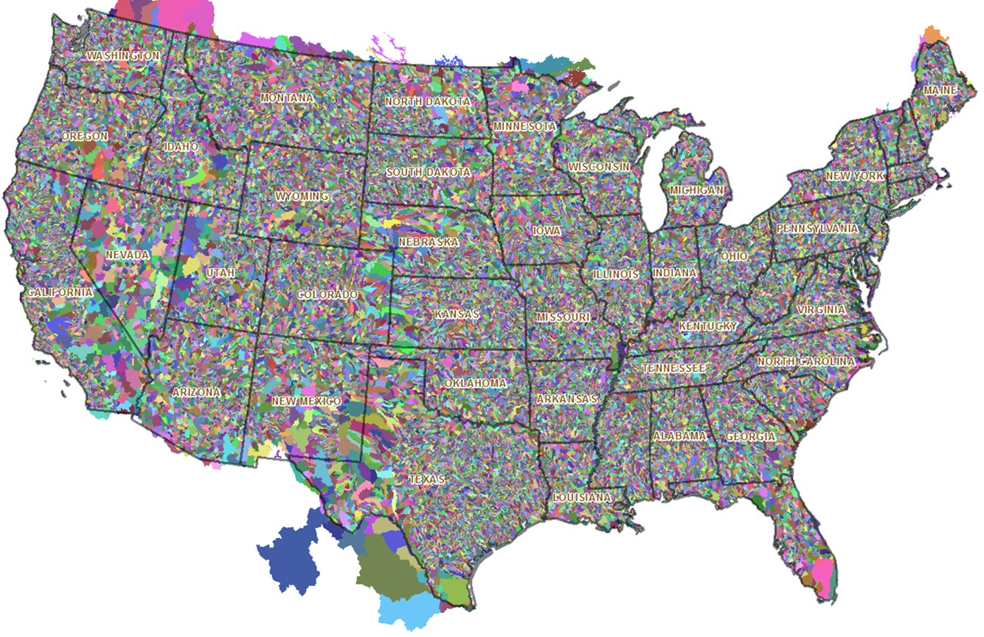
Dimensions of the analysis
Model parameters (35)
Output variables (8)
Statistics for each output variable (7)
Each Hydrologic Response Unit (~110,000)

Slide 10
Dimensions of the analysis
Model parameters (35)
Output variables (8)
Statistics for each output variable (7)
Each Hydrologic Response Unit (~110,000)
10 years of daily values with 3 year warmup

Slide 11
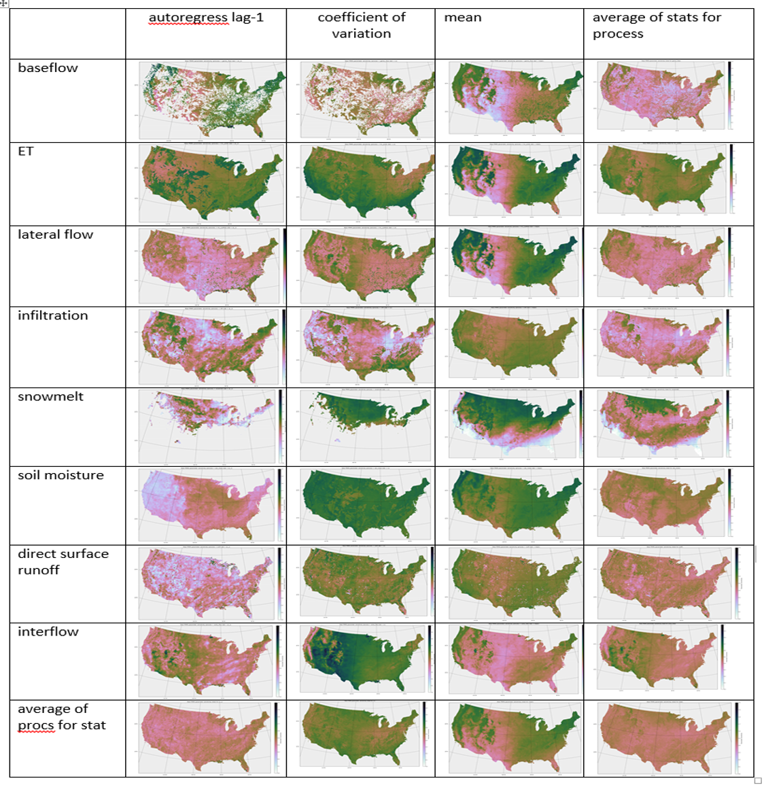
PRMS Parameter Sensitivity at CONUS Scale

Slide 12
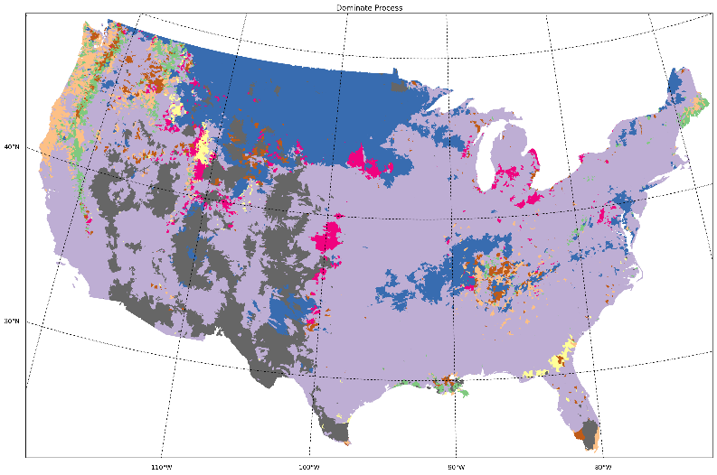
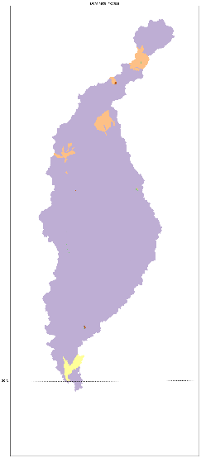
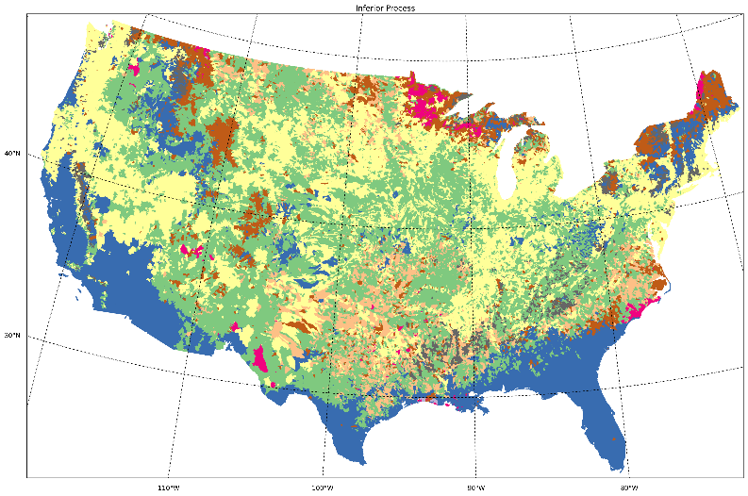
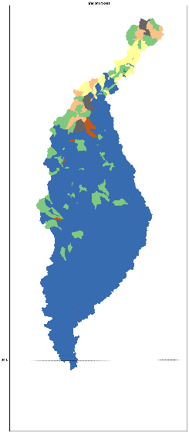
PRMS Parameter Sensitivity at CONUS Scale
Explanation
Baseflow
ET
Runoff
Infiltration
Snowmelt
Soil Moisture
Surface Runoff
Interflow

Slide 13
Process | Performance Measure
 | Mean (Volume) | CV (Flashiness) | AR 1 (Timing)
Baseflow | jh_coef (100), soil_moist_max (91), dday_intcp (81), soil2gw_max (74), radmax (64), carea_max (37, jh_coef_hru (36) | gwflow_coef (48), soil_moist_max (40), jh_coef (28), soil2gw_max (28), smidx_coef(20), carea_max(16), tmax_allsnow(13), dday_intcp(12), smidx_exp (8) | gwflow_coef (48), soil_moist_max (44), soil2gw_max (22), carea_max (18)
Evapo-transpiration | jh_coef (100), soil_moist_max (96), dday_intcp (96), radmax (92), jh_coef_hru (62), smidx_coef (37), dday_slope (25) | radmax(100), jh_coef (100), soil_moist_max (95), dday_intcp (73), dday_slope (67), soil_rechr_max (34) | jh_coef(100), radmax(100), dday_slope(75), soil_moist_max(74), dday_intcp(67), soil_rechr_max(49)
Runoff | jh_coef(100), dday_intcp(96), soil_moist_max(96), radmax(93), jh_coef_hru(62), smidx_coef(37), dday_slope(26) | gwflow_coef(97), soil_moist_max(81), fastcoef_lin(76), pref_flow_den(71), carea_max(58), jh_coef(54), smidx_exp(49), smidx_coef(42), soil2gw_max(36), tmax_allsnow(15) | slowcoef_sq(90), soil2gw_max(90), gwflow_coef(82), carea_max(81), soil_moist_max(78), smidx_exp(72), smidx_coef(60), fastcoef_lin(36), pref_flow_den(35), jh_coef(30), slowcoef_lin(22)
Infiltration | smidx_exp(99), soil_moist_max(99), carea_max(99), smidx_coef(95), jh_coef(64), srain_intcp(50) | carea_max(80), tmax_allsnow(69), jh_coef(63), smidx_exp(62), srain_intcp(54), smidx_coef(54), tmax_allrain(48), radmax(37), freeh2o_cap(36), soil_moist_max(35), dday_intcp(31), rad_trncf(18) | carea_max(72), soil_moist_max(64), smidx_exp(61), tmax_allsnow(60), srain_intcp(60), tmax_allrain(42), jh_coef(35), smidx_coef(24), freeh2o_cap(16), dday_intcp(16)

Slide 14
Process | Performance Measure
 | Mean (Volume) | CV (Flashiness) | AR 1 (Timing)
Snowmelt | tmax_allsnow(96), tmax_allrain(92) | tmax_allsnow(39), tmax_allrain(38), rad_trncf(9), freeh2o_cap(8), dday_intcp(7) | tmax_allsnow(34), dday_intcp(29), rad_trncf(28), radmax(24), tmax_allrain(17), jh_coef(15), freeh2o_cap(14), cecn_coef(14), emis_noppt(13), jh_coef_hru(13), potet_sublim(10)
Soil moisture | soil_moist_max(100), jh_coef(99), dday_intcp(94), radmax(82) | jh_coef(98), radmax(98), soil_moist_max(97), dday_intcp(94) | soil_moist_max(99), jh_coef(98), dday_intcp(89), radmax(35)
Surface runoff | smidx_exp(98), carea_max(98), soil_moist_max(98), smidx_coef(96), jh_coef(90), dday_intcp(33) | carea_max(93), smidx_exp(82), jh_coef(64), tmax_allsnow(55), smidx_coef(52), srain_intcp(33), soil_moist_max(23), tmax_allrain(22) | soil_moist_max(92), carea_max(83), jh_coef(65), smidx_exp(64), smidx_coef(42), tmax_allsnow(39), dday_intcp(25), srain_intcp(23), tmax_allrain(16), radmax(15)
Interflow | soil_moist_max(99), soil2gw_max(94), pref_flow_den(90), jh_coef(84), carea_max(65), smidx_exp(45), dday_intcp(31), smidx_coef(19) | fastcoef_lin(100), soil_moist_max(87), pref_flow_den(71), jh_coef(61), carea_max(49), soil2gw_max(29), smidx_exp(25), tmax_allsnow(17), dday_intcp(16) | soil_moist_max(96), fastcoef_lin(89), slowcoef_sq(83), carea_max(72), jh_coef(61), pref_flow_den(47), smidx_exp(47), ssr2gw_exp(40), soil2gw_max(26), dday_intcp(18), tmax_allsnow(16)

Slide 15
Parameter name | Description | PRMS module
adjmix_rain | Factor to adjust rain proportion in a mixed rain/snow event | climate
carea_max | Maximum area contributing to surface runoff | surface runoff
cecn_coef | Convection con­densation energy coefficient | snow
dday_intcp | Intercept in degree-day equation | solar radiation
dday_slope | Slope in degree-day equation | solar radiation
emis_noppt | Average emissivity of air on days without precipi­tation | snow
fastcoef_lin | Linear coefficient in equation to route preferential-flow | soil-zone
fastcoef_sq | Non-linear coefficient in equation to route preferential-flow | soil-zone
freeh2o_cap | Free-water holding capacity of snowpack | snow
gwflow_coef | Linear groundwater discharge coefficient | groundwater
jh_coef | Coefficient used in Jensen-Haise potential ET computations | Potential ET
jh_coef_hru | Coefficient used in Jensen-Haise potential ET computations | Potential ET
potet_sublim | Snow sublimation fraction of potential ET | snow
ppt_rad_adj | Solar radiation adjustment threshold for precipitation days | solar radiation
pref_flow_den | Fraction of the soil zone in which preferential flow occurs | soil-zone
rad_trncf | Winter transmission coefficient for short-wave radiation | snow
radj_sppt | Solar radiation adjustment on summer precipitation days | solar radiation
radj_wppt | Solar radiation adjustment on winter precipitation days | solar radiation
radmax | Maximum solar radiation due to atmospheric effects | solar radiation
sat_threshold | Water capacity between field capacity and total saturation | soil-zone

Slide 16
Parameter name | Description | PRMS module
slowcoef_lin | Linear coefficient for interflow routing | soil-zone
slowcoef_sq | Non-linear coefficient for interflow routing | soil-zone
smidx_coef | Non-linear contributing area coefficient | surface runoff
smidx_exp | Exponent in non-linear contributing area coefficient | surface runoff
soil2gw_max | Maximum soil water excess that is routed directly to groundwater | soil-zone
soil_moist_max | Maximum available water holding capacity of soil-zone | soil-zone
soil_rechr_max | Maximum available water holding capacity of recharge zone | soil-zone
srain_intcp | Summer rain interception storage capacity | interception
ssr2gw_exp | Non-linear coefficient in equation used to route soil-zone water to groundwater | soil-zone
ssr2gw_rate | Linear coefficient in equation used to route soil-zone water to groundwater | soil-zone
tmax_allrain | Maximum air temperature above which precipitation is rain | climate
tmax_allsnow | Maximum air temperature below which precipitation is snow | climate
tmax_index | Tempera­ture to determine precipitation adjust­ments to solar radiation | solar radiation
transp_tmax | Temperature that determines start of the transpiration period | evaporation
wrain_intcp | Winter rain interception storage capacity | interception

